Slide 1
Python
Session – 7
Date – 26th May, 2022

Slide 2
Python Exception
An exception can be defined as an unusual condition in a program resulting in the interruption in the flow of the program.
Whenever an exception occurs, the program stops the execution, and thus the further code is not executed. Therefore, an exception is the run-time errors that are unable to handle to Python script. An exception is a Python object that represents an error
Python provides a way to handle the exception so that the code can be executed without any interruption. If we do not handle the exception, the interpreter doesn't execute all the code that exists after the exception.
Python has many built-in exceptions that enable our program to run without interruption and give the output.

Slide 3
Common Exceptions
Python provides the number of built-in exceptions, but here we are describing the common standard exceptions. A list of common exceptions that can be thrown from a standard Python program is given below.
ZeroDivisionError: Occurs when a number is divided by zero.
NameError: It occurs when a name is not found. It may be local or global.
IndentationError: If incorrect indentation is given.
IOError: It occurs when Input Output operation fails.
EOFError: It occurs when the end of the file is reached, and yet operations are being performed.

Slide 4
Common Exceptions
#Zero Division Error
#print(10 / 0)
#NameError
#print(var) since var is not defined anywhere in the code interpretor is not able to find it
#IndentationError
# print("Hello")
#IOError
#f = open("file.txt", "r")
#EOFErros
#num1 = int(input("Enter Value 1: "))
#num2 = int(input("Enter Value 2: ")) #if you hit enter this will throw an EOFErrors
#sum = num1 + num2
#print(sum)

Slide 5
The problem without handling exceptions
As we have already discussed, the exception is an abnormal condition that halts the execution of the program.
Suppose we have two variables a and b, which take the input from the user and perform the division of these values. What if the user entered the zero as the denominator? It will interrupt the program execution and through a ZeroDivision exception.
Example
a = int(input("Enter a:"))
b = int(input("Enter b:"))
c = a/b
print("a/b = %d" %c)
#other code:
print("Hi I am other part of the program")
The above program is syntactically correct, but it through the error because of unusual input. That kind of programming may not be suitable or recommended for the projects because these projects are required uninterrupted execution. That's why an exception-handling plays an essential role in handling these unexpected exceptions.

Slide 6
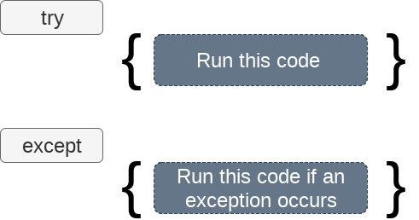
The try-expect statement
If the Python program contains suspicious code that may throw the exception, we must place that code in the try block. The try block must be followed with the except statement, which contains a block of code that will be executed if there is some exception in the try block.
Syntax
try:
#block of code
except Exception1:
#block of code
except Exception2:
#block of code
#other code

Slide 7
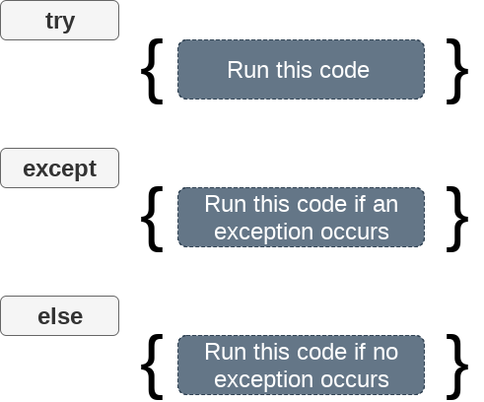
The try-expect else statement
We can also use the else statement with the try-except statement in which, we can place the code which will be executed in the scenario if no exception occurs in the try block.
The syntax to use the else statement with the try-except statement is given below.
try:
#block of code
except Exception1:
#block of code
else:
#this code executes if no except block is executed

Slide 8
The except statement with no exception
Python provides the flexibility not to specify the name of exception with the exception statement.
Consider the following example.
try:
a = int(input("Enter a:"))
b = int(input("Enter b:"))
c = a/b;
print("a/b = %d"%c)
except:
print("can't divide by zero")
else:
print("Hi I am else block")

Slide 9
The except statement using with exception variable
We can use the exception variable with the except statement. It is used by using the as keyword. this object will return the cause of the exception. Consider the following example:
try:
a = int(input("Enter a:"))
b = int(input("Enter b:"))
c = a/b
print("a/b = %d"%c)
# Using exception object with the except statement
except Exception as e:
print("can't divide by zero")
print(e)
else:
print("Hi I am else block")

Slide 10
Declaring Multiple Exceptions
The Python allows us to declare the multiple exceptions with the except clause. Declaring multiple exceptions is useful in the cases where a try block throws multiple exceptions. The syntax is given below.
try:
#block of code
except (<Exception 1>,<Exception 2>,<Exception 3>,...<Exception n>)
#block of code
else:
#block of code

Slide 11
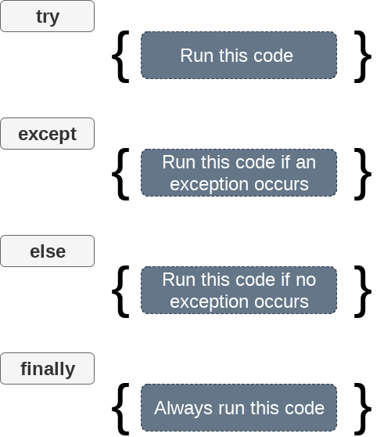
The try...finally block
Python provides the optional finally statement, which is used with the try statement. It is executed no matter what exception occurs and used to release the external resource. The finally block provides a guarantee of the execution.
We can use the finally block with the try block in which we can pace the necessary code, which must be executed before the try statement throws an exception.
The syntax to use the finally block is given below.
try:
# block of code
# this may throw an exception
finally:
# block of code
# this will always be executed

Slide 12
Raising exceptions
An exception can be raised forcefully by using the raise clause in Python. It is useful in in that scenario where we need to raise an exception to stop the execution of the program.
For example, there is a program that requires 2GB memory for execution, and if the program tries to occupy 2GB of memory, then we can raise an exception to stop the execution of the program.
The syntax to use the raise statement is given below.
raise Exception_class,<value>
Points to remember
To raise an exception, the raise statement is used. The exception class name follows it.
An exception can be provided with a value that can be given in the parenthesis.
To access the value "as" keyword is used. "e" is used as a reference variable which stores the value of the exception.
We can pass the value to an exception to specify the exception type.

Slide 13
Raising exceptions
Example
try:
age = int(input("Enter the age:"))
if(age<18):
raise ValueError
else:
print("the age is valid")
except ValueError:
print("The age is not valid")
Example 2 Raise the exception with message
try:
num = int(input("Enter a positive integer: "))
if(num <= 0):
# we can pass the message in the raise statement
raise ValueError("That is a negative number!")
except ValueError as e:
print(e)

Slide 14
Custom Exception
The Python allows us to create our exceptions that can be raised from the program and caught using the except clause. However, we suggest you read this section after visiting the Python object and classes.
Consider the following example.
class ErrorInCode(Exception):
def __init__(self, data):
self.data = data
def __str__(self):
return repr(self.data)
try:
raise ErrorInCode(2000)
except ErrorInCode as ae:
print("Received error:", ae.data)
Output:
Received error: 2000

Slide 15
Python Lambda Functions
Python Lambda function is known as the anonymous function that is defined without a name. Python allows us to not declare the function in the standard manner, i.e., by using the def keyword. Rather, the anonymous functions are declared by using the lambda keyword. However, Lambda functions can accept any number of arguments, but they can return only one value in the form of expression.
The anonymous function contains a small piece of code. It simulates inline functions of C and C++, but it is not exactly an inline function.
The syntax to define an anonymous function is given below.
lambda arguments: expression
It can accept any number of arguments and has only one expression. It is useful when the function objects are required.
x = lambda a:a+10
# Here we are printing the function object
print(x)
print("sum = ",x(20))

Slide 16
Use lambda function with filter()
The Python built-in filter() function accepts a function and a list as an argument. It provides an effective way to filter out all elements of the sequence. It returns the new sequence in which the function evaluates to True.
Consider the following example where we filter out the only odd number from the given list.
#program to filter out the tuple which contains odd numbers
lst = (10,22,37,41,100,123,29)
oddlist = tuple(filter(lambda x:(x%2 != 0),lst)) # the tuple contains all the items of the tuple for which the lambda function evaluates to true
print(oddlist)

Slide 17
Using lambda function with map()
The map() function in Python accepts a function and a list. It gives a new list which contains all modified items returned by the function for each item.
Consider the following example of map() function.
lst = (10,20,30,40,50,60)
square_list = list(map(lambda x:x**2,lst)) # the tuple contains all the items of the list for which the lambda function evaluates to true
print(square_tuple)

Slide 18
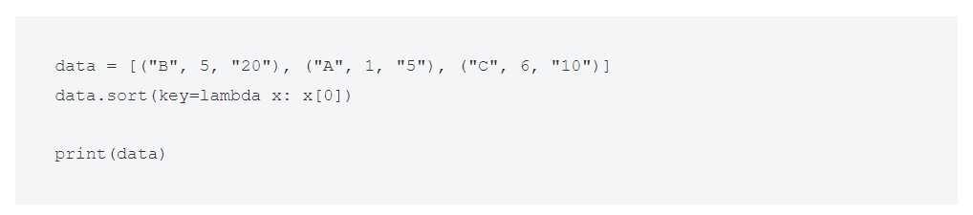
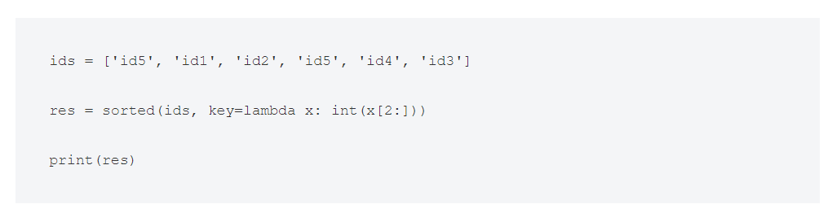
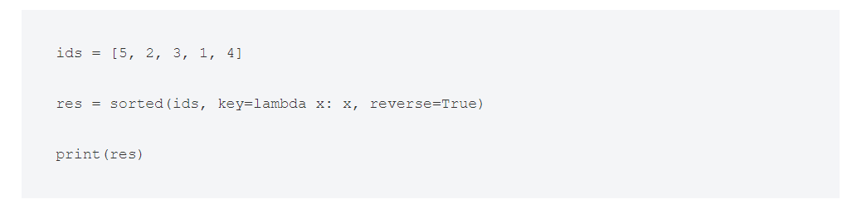
Sort lambda in Python

Slide 19
Using lambda() Function with reduce()
reduce() is another Python function. It applies a rolling calculation to all items in a list. You can use it to calculate the total sum or to multiply all the numbers together.
The reduce() function in Python takes in a function and a list as an argument. The function is called with a lambda function and an iterable and a new reduced result is returned. This performs a repetitive operation over the pairs of the iterable.
The reduce() function belongs to the functools module.
Here the results of previous two elements are added to the next element and this goes on till the end of the list like (((((5+8)+10)+20)+50)+100).
from functools import reduce
li = [5, 8, 10, 20, 50, 100]
sum = reduce((lambda x, y: x + y), li)
print (sum)

Slide 20
Applying aggregate functions in lambda
Test Data Creation
data = { 'id': ['0100', '0200', '0100', '0200', '0300’],
'client_name': ['Ann', 'Bob', 'Ann', 'Bob', 'Charles’],
'product': ['pen', 'paper', 'folder', 'pencil', 'tray’],
'count': [12, 300, 5, 12, 10],
'price': [2.00, 5.00, 3.50, 2.30, 8.20],
'discount': [0.0, 0.1, 0.15, 0.1, 0.12]}
df = pd.DataFrame(data) print(df)
# Use either one of the following 2 lines of codes:
summary = df.groupby('client_name').apply(f) # Using the customized function f() defined above
# or using lambda function
summary = df.groupby('client_name').apply(lambda x: pd.Series({'Total pre discount’: (x['price'] * x['count']).sum(), 'Discount applied': (x['price'] * x['count'] * x['discount']).sum()})) print(summary)

Slide 21
Conditional statements with lambda function
Example:
To Write same with lambda function
T = 250
if (T > 200):
rate = 200*exp(-T)
else:
rate = 400*exp(-T)
return (rate)
rate = lambda T: 200*exp(-T) if T>200 else 400*exp(-T)

Slide 22
Filtering Dictionary
l = [{'abc': 'def'}, {'ghi': 'jul'}, {'Name': 'my-name’}]
The following produces a list of dictionaries that have the key 'Name':
filtered = list(filter(lambda x: x.get('Name'), l))
From here, you can retrieve the name values for all items in the list:
values = [x['Name'] for x in filtered]

